Slide 1
M A S T E R P L A N
AIRPOR T BUSINESS PARK PROGRAM GRANT
1

Slide 2
PROJECT BACKGROUND
Funds available via LB1024 by State Sen. Wayne & McKinney.
Authorized use of Coronavirus State and Local Fiscal Recovery Fund (SLFRF).
Total LB 1024 grant award $60 million.
Additional $30 Million authorized under LB 531 in 2023.
$90 Million total in available funding.
Master Plan developed in 2023.
Utilized work from 2021 update to 2011 Site Development Study.

Slide 3
PROJECT GOALS
Creation of quality jobs in or adjacent to a Qualified Census Tract (QCT).
Attract new employers to Nebraska.
Spur wider economic and community development.
Create opportunities for job training and advancement.
Create a beautiful and attractive environment with varied transportation and access options.

Slide 4
WHAT IS A QUALITY JOB?
No widely accepted definition of a “quality job.”
At a minimum, good jobs pay sustainable wages and offer
career advancement.
Provides opportunities across a spectrum of skill levels and industries to build advancement into the community’s economic structure.
Quality jobs “ensures a steady improvement in the standard of living for the middle class and a way out of poverty for low-income Americans.”
–A Future of Good Jobs, Upjohn Institute for Employment Research

Slide 5
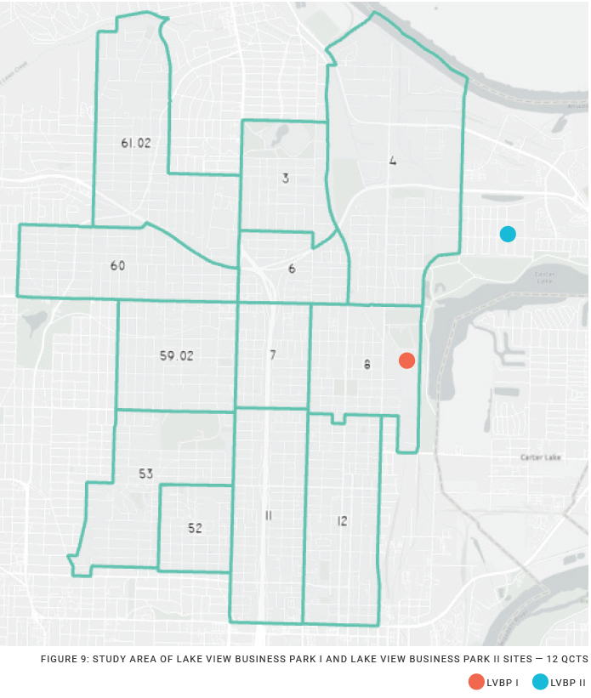
STUDY AREA & COMMUNITY
12 QCTs in North Omaha.
Total households: 15, 291.
Median household income: $32, 582.
30% of households below poverty level.
Unemployment rate: 9.2%
5.5% higher than national average.
5.5% of households have no vehicle access.

Slide 6
PROJECT LOCATIONS
Two sites in close proximity to each other, Carter Lake and Levi Carter Park.
Previously known as Enterprise Industrial Park & Airport Business Park II.
Envisioned as Lake View Business Park I (LVBP I) and Lake View Business Park II (LVBP II).

Slide 7
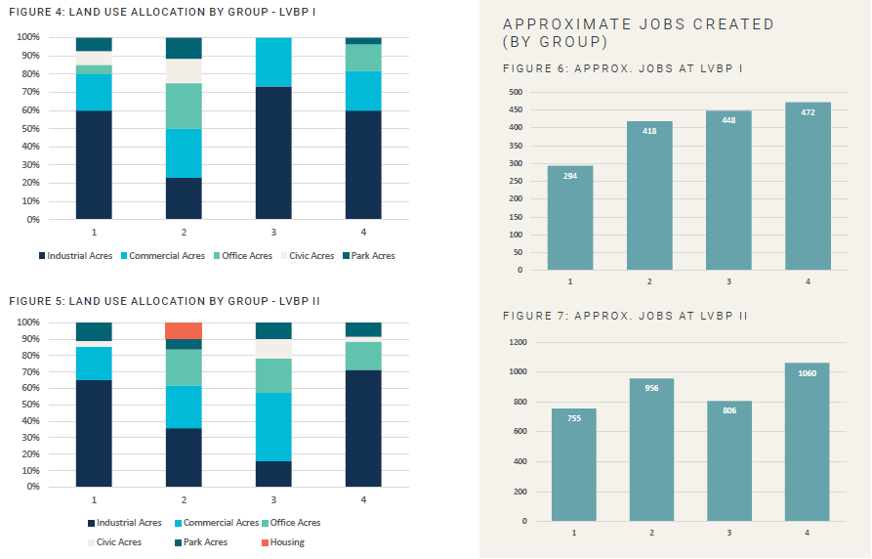
STAKEHOLDER INPUT
Participants from 15 community / stakeholder organizations attended two workshops.
Stakeholders provided input on vision, community needs, potential challenges, desired outcomes, and land use.

Slide 8
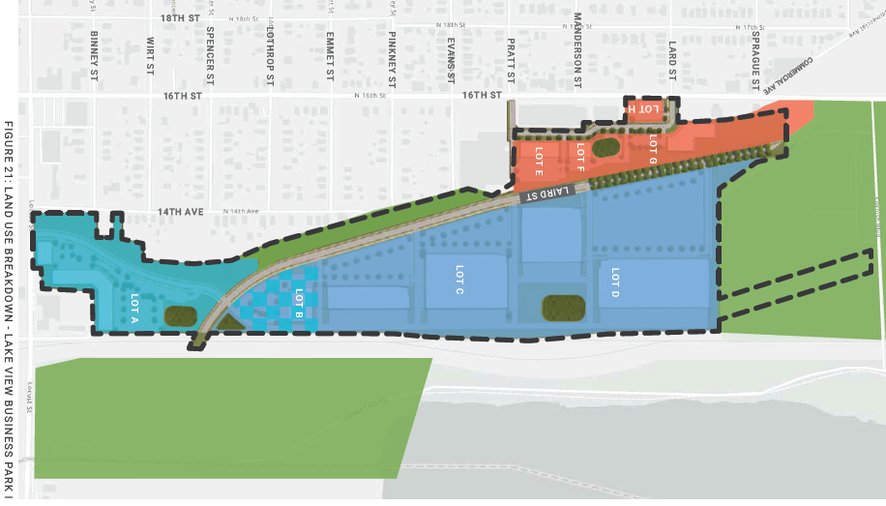
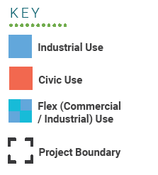
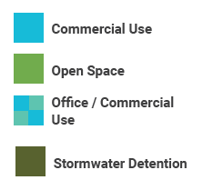
LAND USE – LVBP I

Slide 9
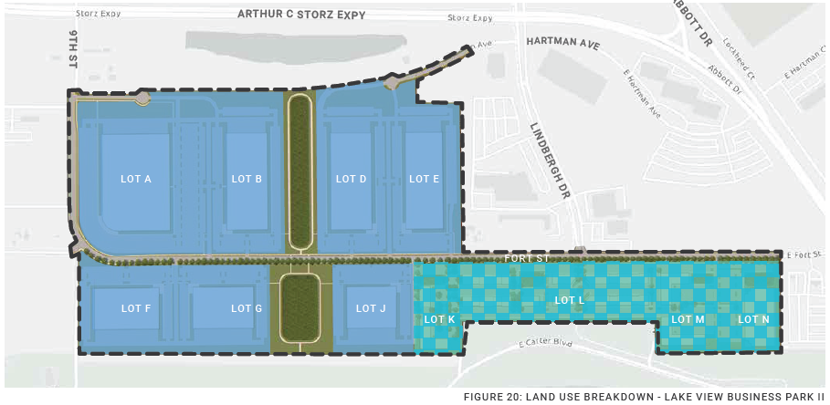
LAND USE – LVBP II

Slide 10
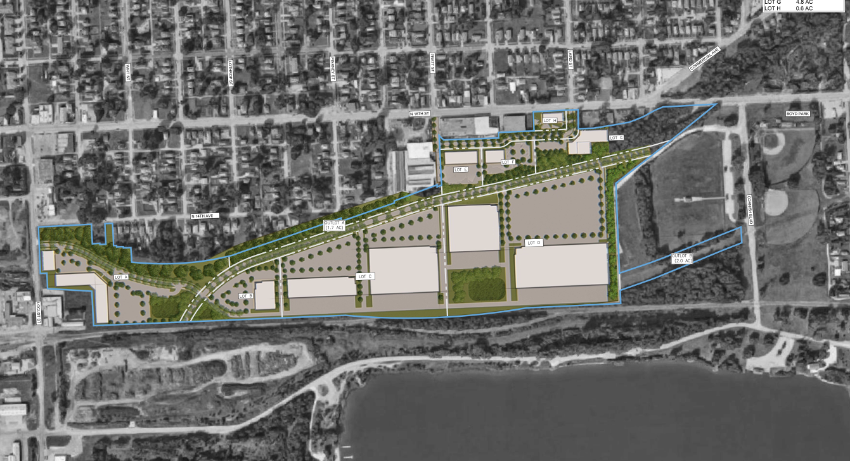
LAKE VIEW BUSINESS PARK I

Slide 11
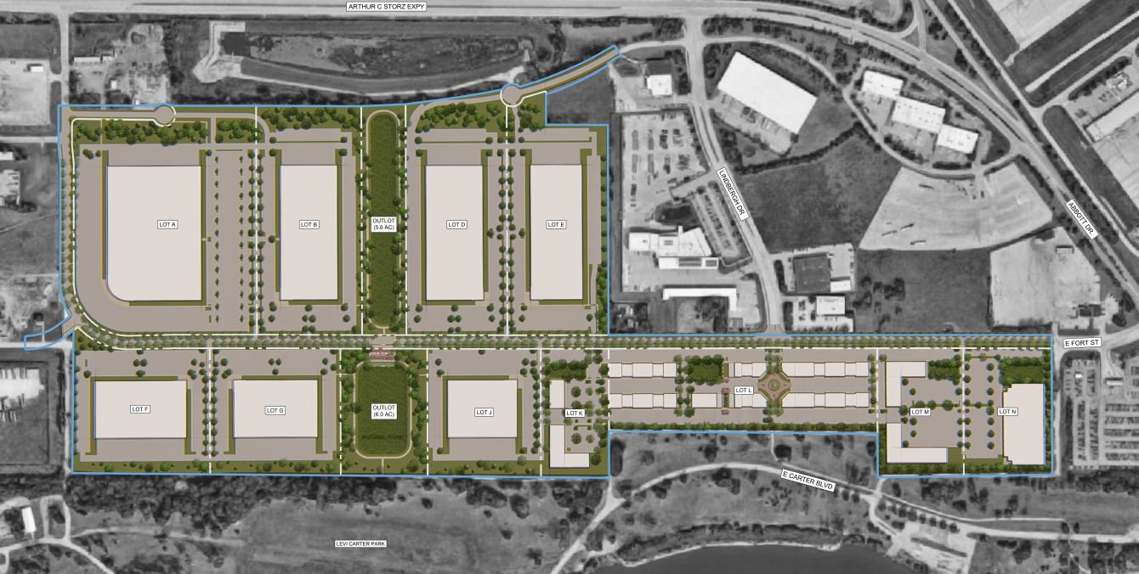
LAKE VIEW BUSINESS PARK II

Slide 12
TOTAL ECONOMIC IMPACT
The economic analysis for the two Business Parks shows:
1,600 new, permanent jobs created Manufacturing & Business Supportive Services.
$604 Million added to the Nebraska economy each year, once fully operational.
$176 Million boost to earnings in the local economy.
An additional 1,718 construction jobs during construction of the buildings.
*Analysis assumes $160 Million in Manufacturing Construction investment. and $59.7 Million in Commercial Construction investment.

Slide 13
ECONOMIC IMPACT BY SITE
Metric | LVBP I | LVBP II
Permanent Jobs Created | 482 | 1,182
Amount Added to Nebraska Economy | $180 Million | 424.6 Million
Boost to Local Economy | $52.9 Million | $123.4 Million
Construction Jobs Created | 480 | 1,238

Slide 14
SITE CONDITIONS
LVBP I
Significant grade changes.
Rubble beneath surface.
History of illegal waste dumping.
Underground storage tanks.
Significant infrastructure required.
LVBP II
Significant property acquisition required.
Potential environmental concerns; potential lead/asbestos.
Significant infrastructure required.

Slide 15
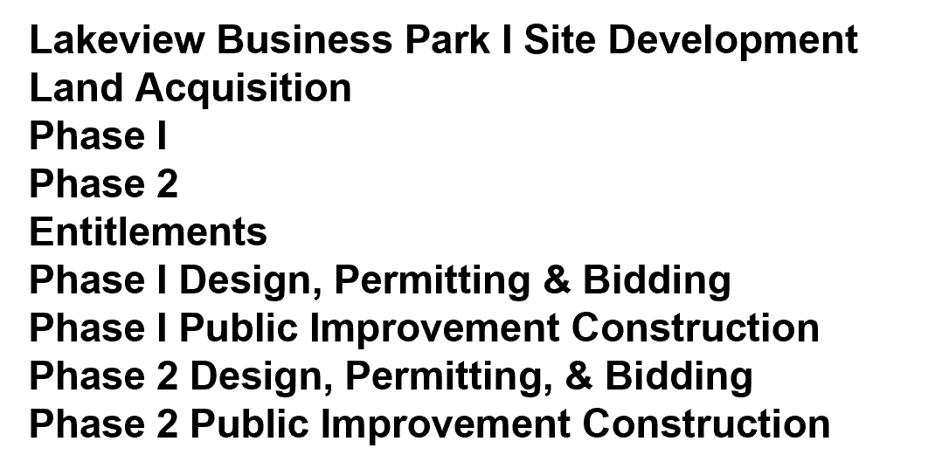
CONCEPTUAL SCHEDULE
LAKEVIEW BUSINESS PARK I
YEAR 1
YEAR 2
YEAR 3
LAKEVIEW BUSINESS PARK II
YEAR 1
YEAR 2
YEAR 3
YEAR 4

Slide 16
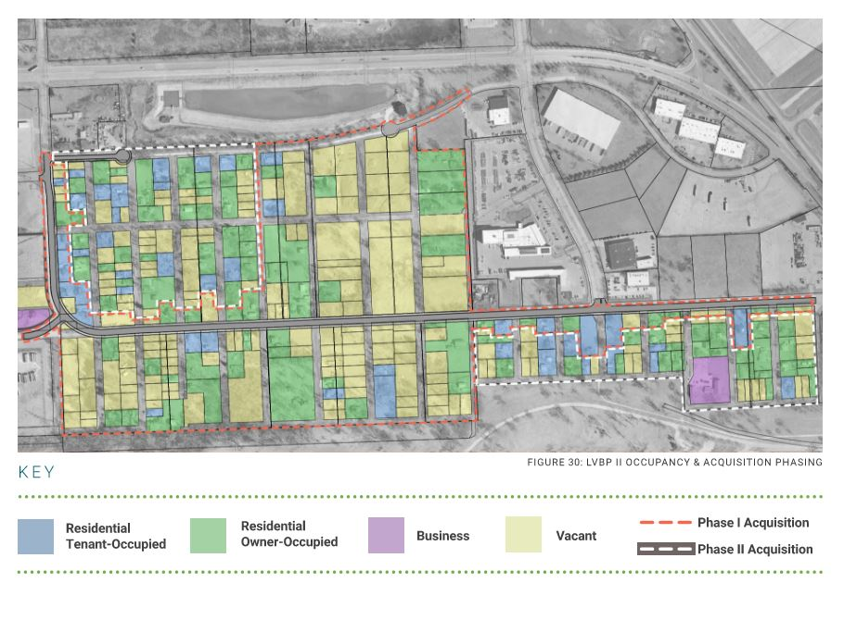
ACQUISITION STRATEGY
Substantial thought has been
put into crafting a resident-friendly
acquisition strategy.
Midwest ROW will recommend
Just Compensation amounts that will
be offered to Sellers.
LVBP II Phase I –
176 parcels
119 vacant (68%)
LVBP II Phase II –
147 parcels
68 vacant (46%)

Slide 17
MEDIA RESPONSE
Community Engagement + Site Acquisition
Plan was not meant to be public at this early stage.
We were just awarded the grant in January.
There would have been no project without the grant award.
The general concept for the business park has existed over 10 years. The legislation was based on this existing concept.
The legislation specified a location within 2-miles of the airport.
The goal is to acquire property on a 100% voluntary basis.
We will continue to further engage the community to incorporate feedback into the plan. This development is being created for the community.

Slide 18
COST ESTIMATES
Lake View Business Park II (aka Airport Business Park)
Phase I: $70,816,430
Phase II: $66,923,735
LVBP II Combined Total: $137.7 M
Lake View Business Park I (aka Enterprise)
Total: $61,627,100

Slide 19
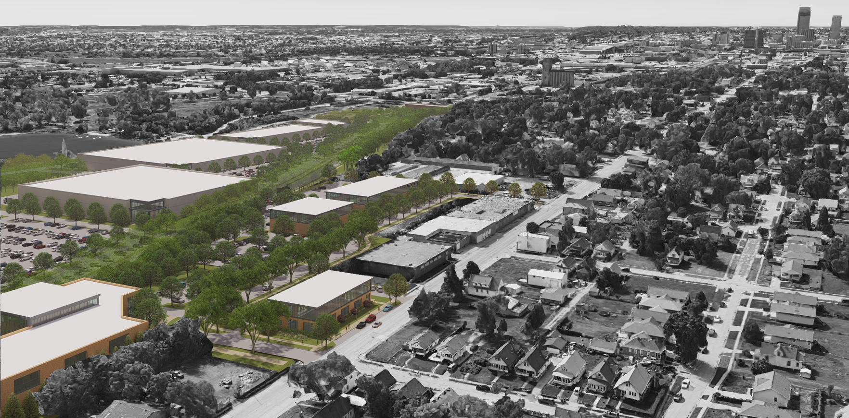
LVBP I (LOOKING SOUTH DOWN N. 16TH STREET)

Slide 20
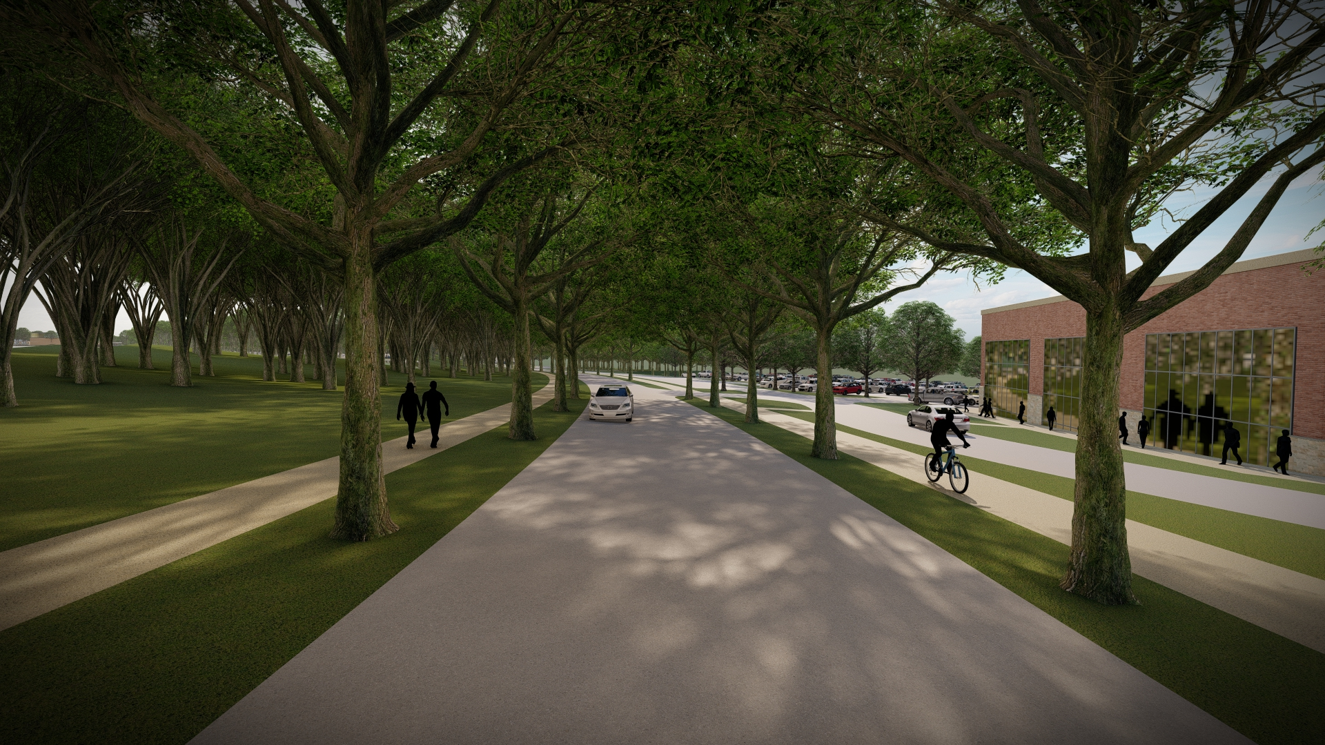
LVBP I (MAJOR INDUSTRIAL COLLECTOR ROAD)

Slide 21
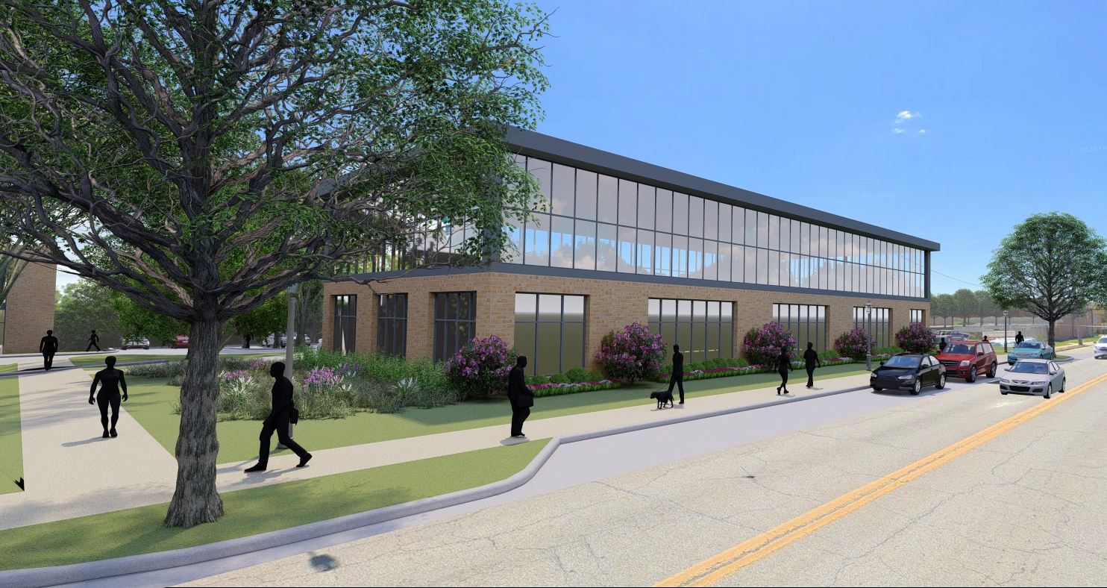
LVBP I (STREET VIEW ON N. 16TH STREET)

Slide 22
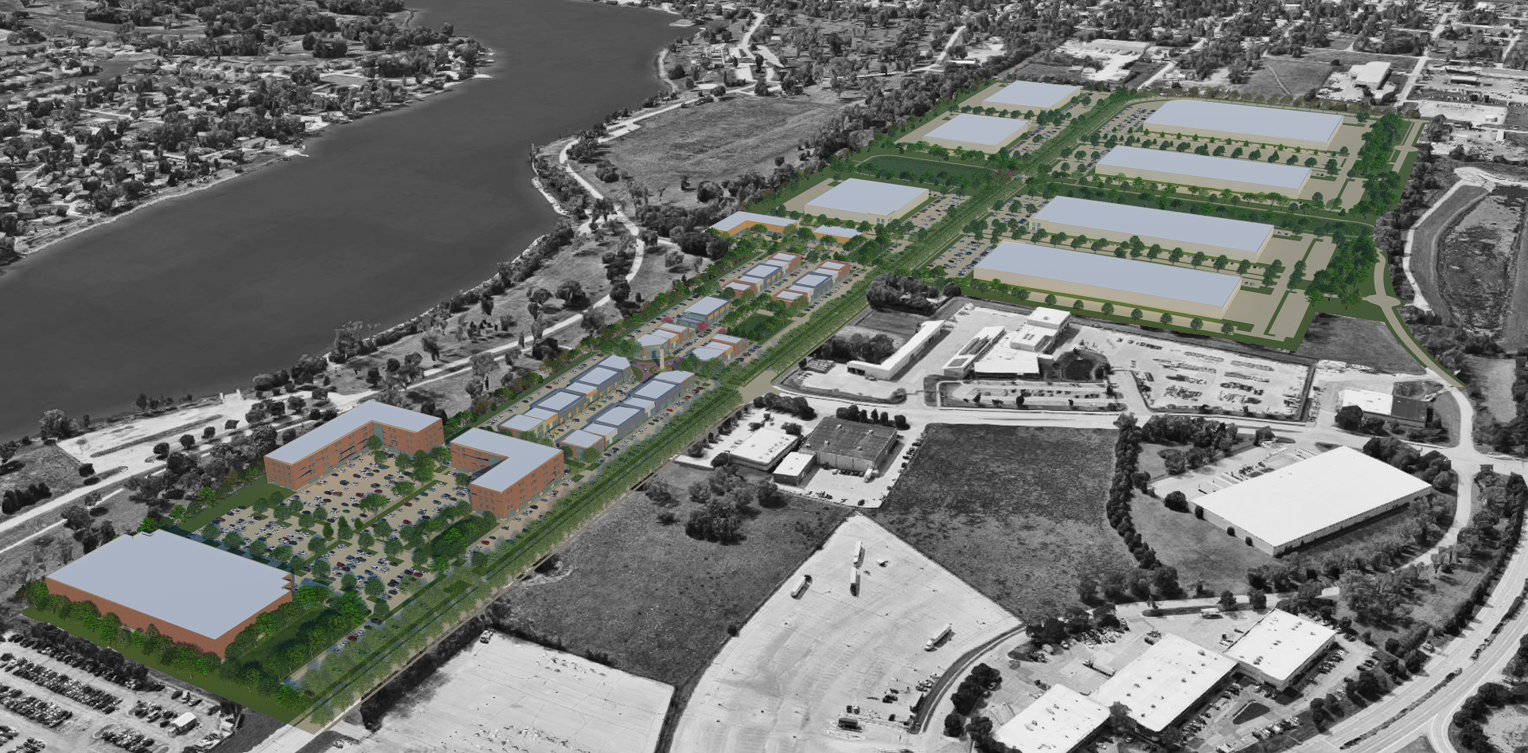
LVBP II (LOOKING WEST DOWN FORT STREET)

Slide 23
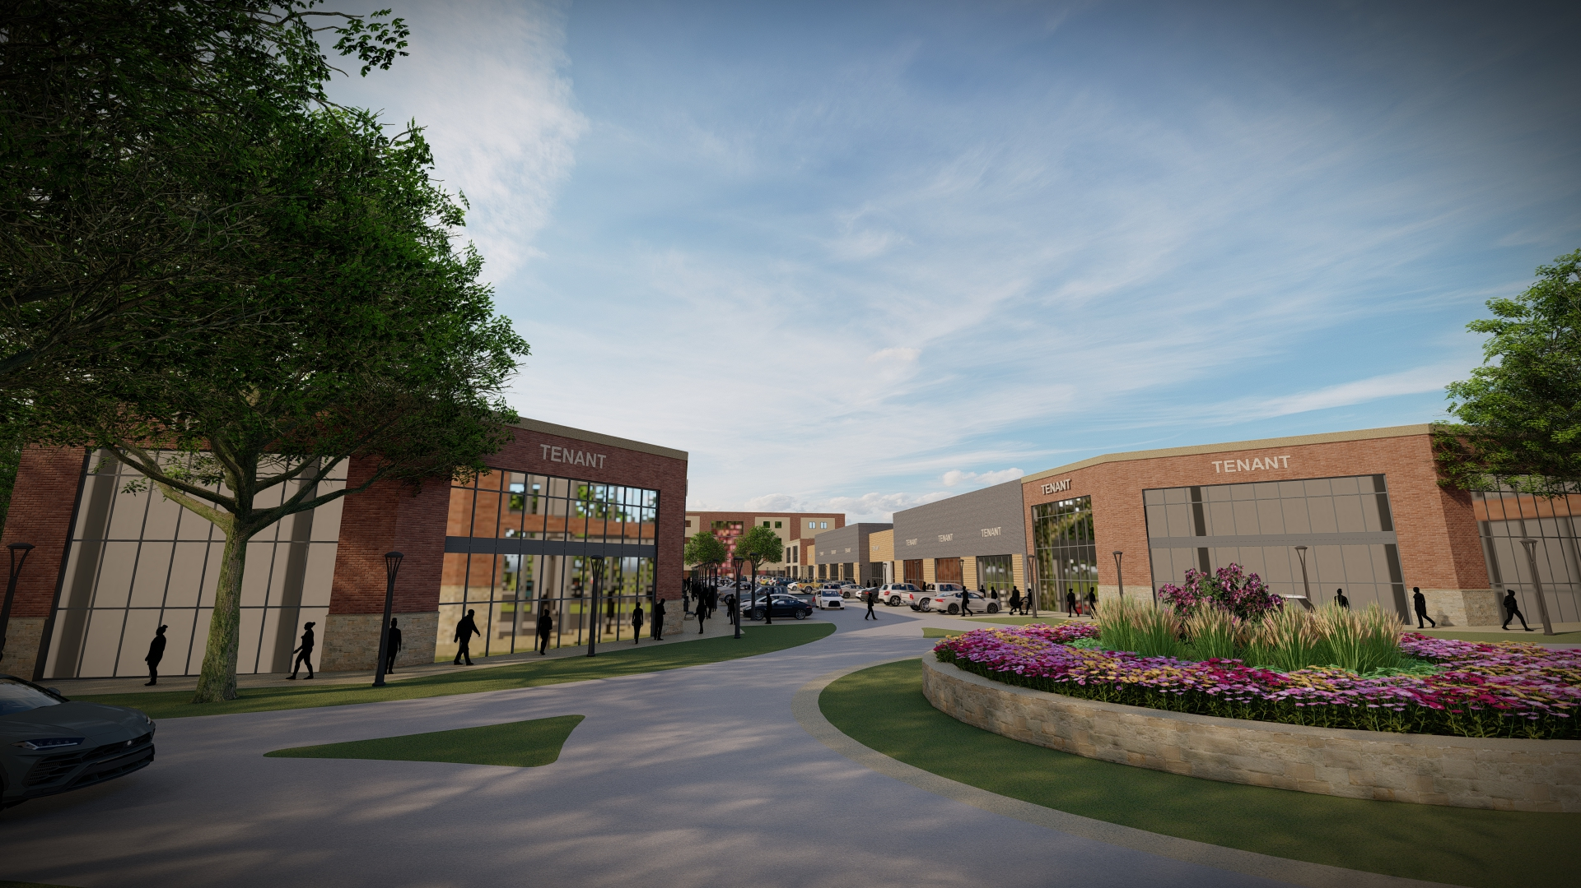
LVBP II – TRAFFIC CIRCLE, COMMERCIAL CORRIDOR

Slide 24
PROJECT TEAM
Real Estate Development
Omaha Economic Development Corporation (OEDC)
and Burlington Capital have partnered to lead the project
and serve as the developers of the real estate.
Economic Development
Greater Omaha Chamber of Commerce will
lead efforts for business recruitment and
marketing.

Slide 25
BUSINESS RECRUITMENT
Project Activity
Existing Interest
Proactive Marketing
Workforce Training Partners

Slide 26
CONTRIBUTORS
City of Omaha – Public Works
City of Omaha – Planning
Metropolitan Utilities District
Omaha Public Power District
Lamp Rynearson
Midwest Right of Way
Thiele Geotech

Slide 27
THANK YOU
We thank you for this opportunity and consideration.
We see this as the opportunity of a lifetime to create a lifetime of opportunity for the residents of North Omaha and the larger community.

